Slide 1
CSC8631: Data Management and Exploratory Data Analysis
03 December, 2021
Simon Irvine 210449787

Slide 2


Hello!
I am Simon Irvine
MSc Digital Technology Solutions (Data Analytics(
You can find me at:
@github.com/simontirvine

Slide 3
1.
The Brief
Scenario and challenge

Slide 4
You will develop a data analysis pipeline to explore a given dataset.

Slide 5
The Challenge
FutureLearn MOOC
Cyber Security: Safety at Home, Online, in Life
Seven runs from 2018-2016
There are no formal requirements for the functionality or focus of your analysis.
Write your code incrementally, and test it carefully before continuing to add additional functionality.

Slide 6
Success criteria
Data are imported and processed allowing exploratory data analysis;
A repository and version control system is established;
Appropriate questions are asked throughout to further analysis;
Processes and code are understandable and reproducible;
A final report is produced.

Slide 7
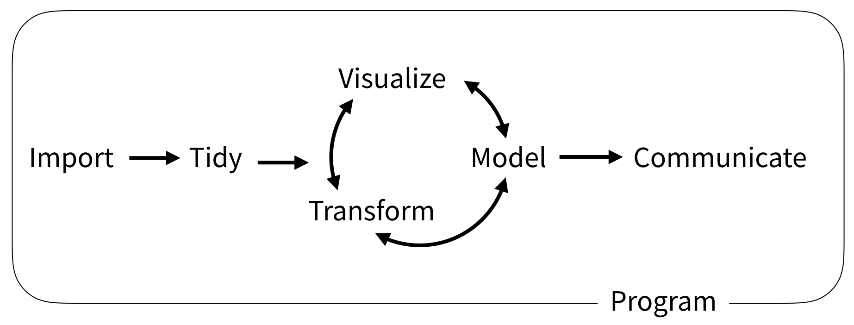

Slide 8
1.
Import
Preparing and collecting

Slide 9

Reproducibility
Structured
Reporting
Literate Programming
Version Control

Slide 10
2.
Tidy
Exploring and pre-processing

Slide 11
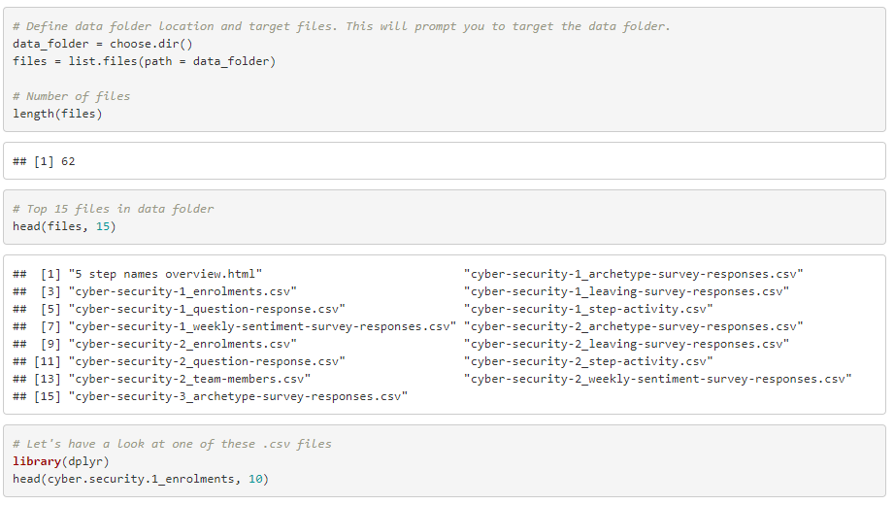

Slide 12
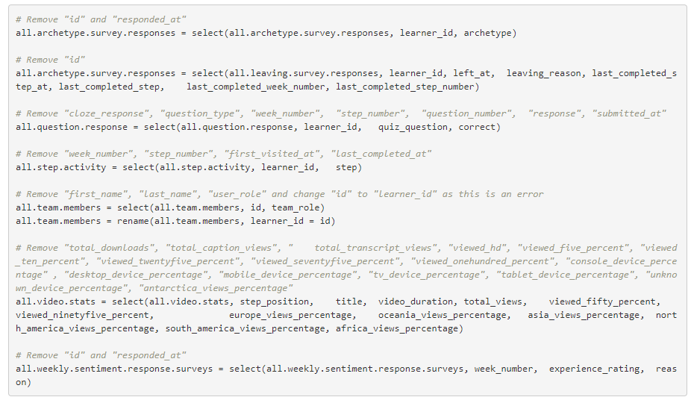

Slide 13
3.
The Loop
Transforms, Visualize and Model

Slide 14
Questions
?
What can we learn about the people who registered for this MOOC?
Does gender play a role?
How popular were the videos?

Slide 15
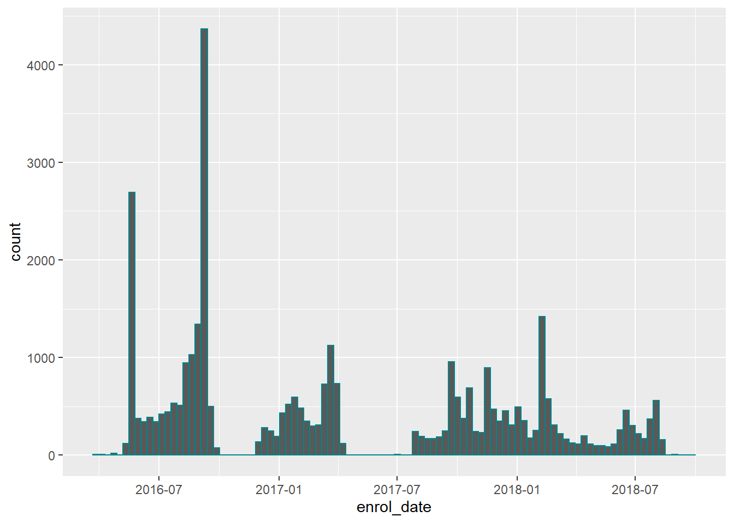
Enrolments against date
Why are there such large spikes of enrolment in 2016? Was there a marketing drive?
It would be good to know when the MOOC runs began and finished to delineate the groupings.
It is clear registration was open after each course started

Slide 16
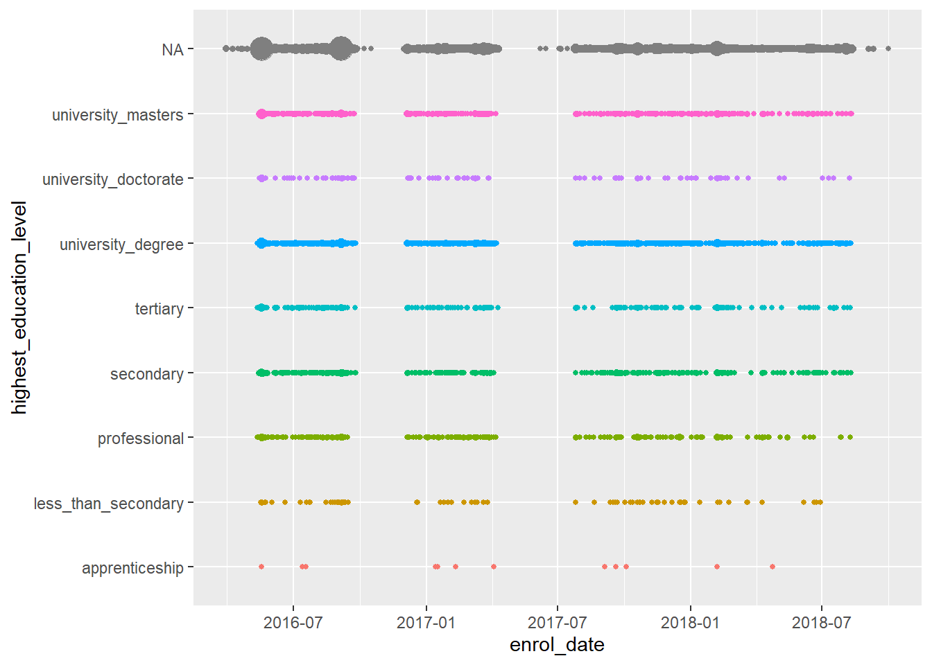
Enrolments over time against highest education level
What does NA mean in this context? No education (unlikely, as secondary is an option) or learners did not complete the form.
Overall it clear there were fewer outliers (PhD holders and less than secondary) which is not surprising. There seems to be a fairly even distribution across all other education levels.

Slide 17
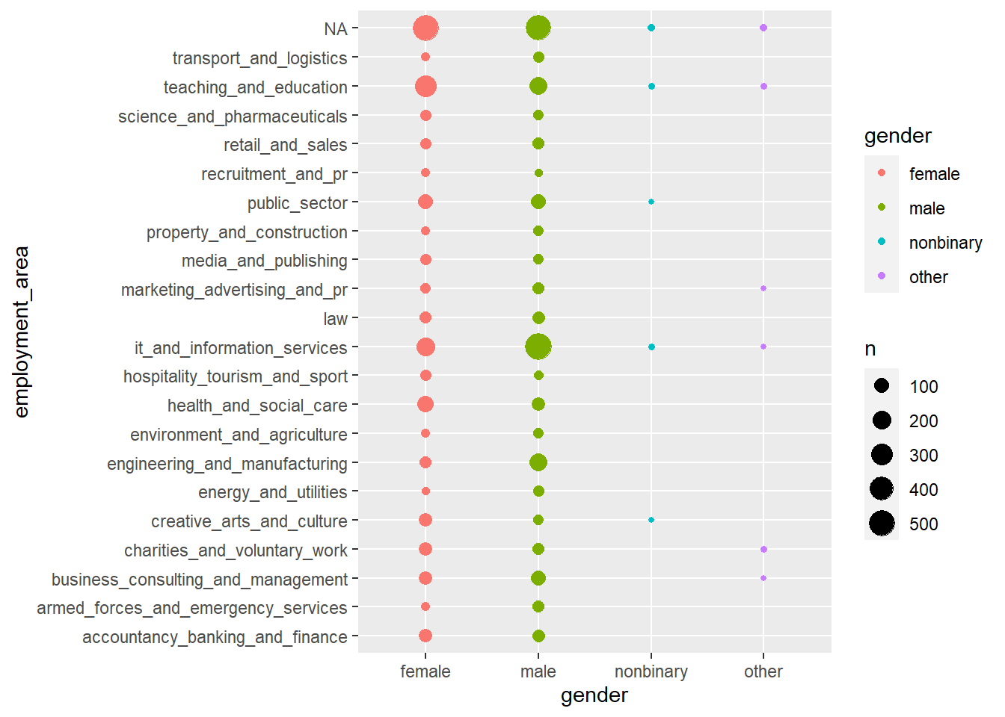
Employment area against gender
There is a slightly greater number of females working in teaching and education and accounting on the course.
There is a noticeably greater number of males working in IT and information services and engineering on the course.
Most other categories have an equal distribution.
Nonbinary and other genders are represented in teaching, marketing, IT, voluntary and business consulting.

Slide 18
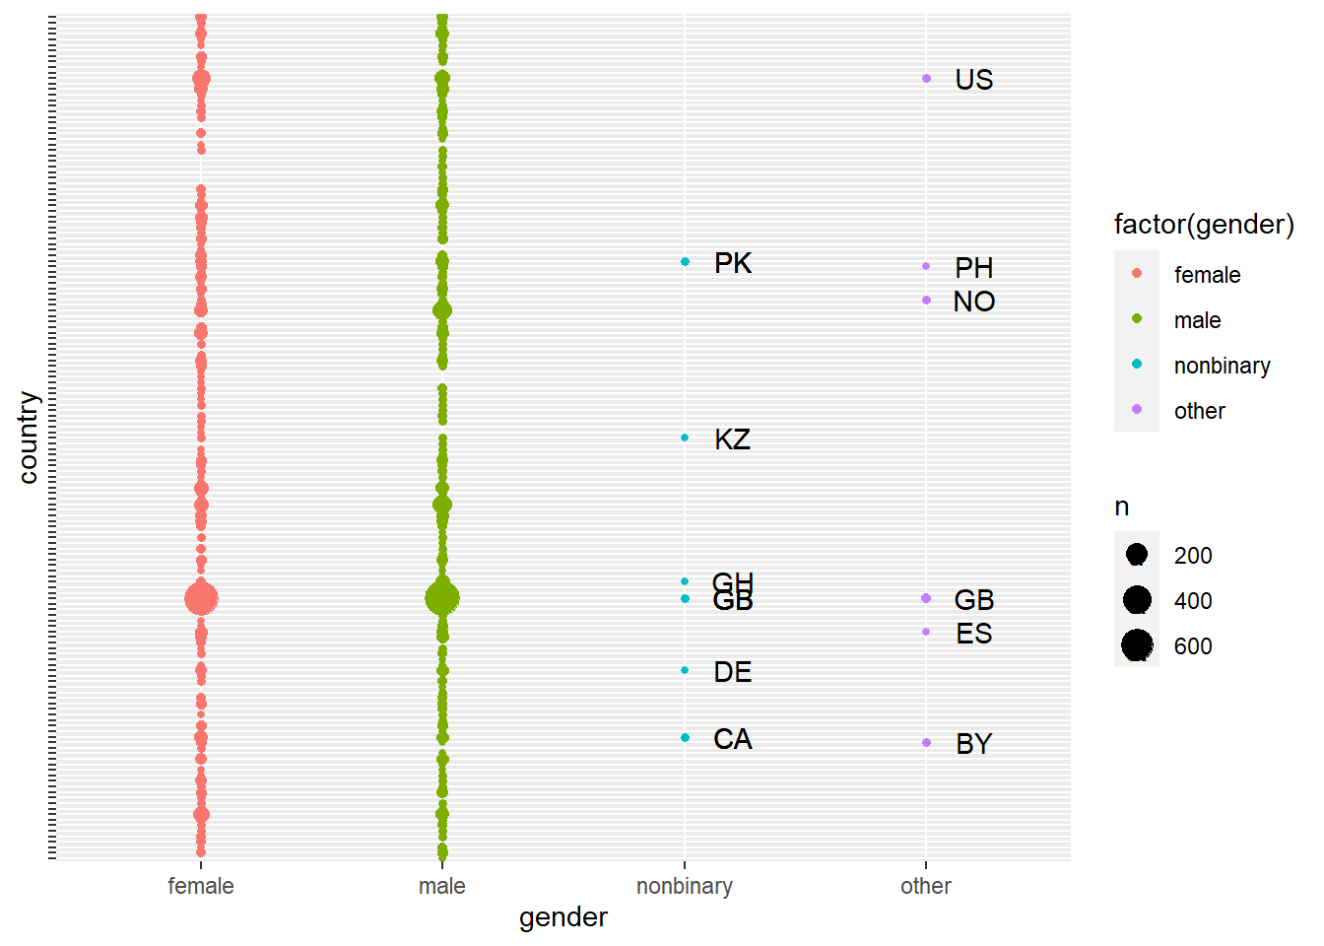
Genders against Country )learners(
Nonbinary learners registered home countries as Pakistan, Kazakhstan, Ghana, UK, Germany and Canada.
Other gender learners registered home countries as US, Norway, Philippines, UK, Spain and Bulgaria.
Unsurprisingly, regardless of gender, UK learners represented the largest group.

Slide 19
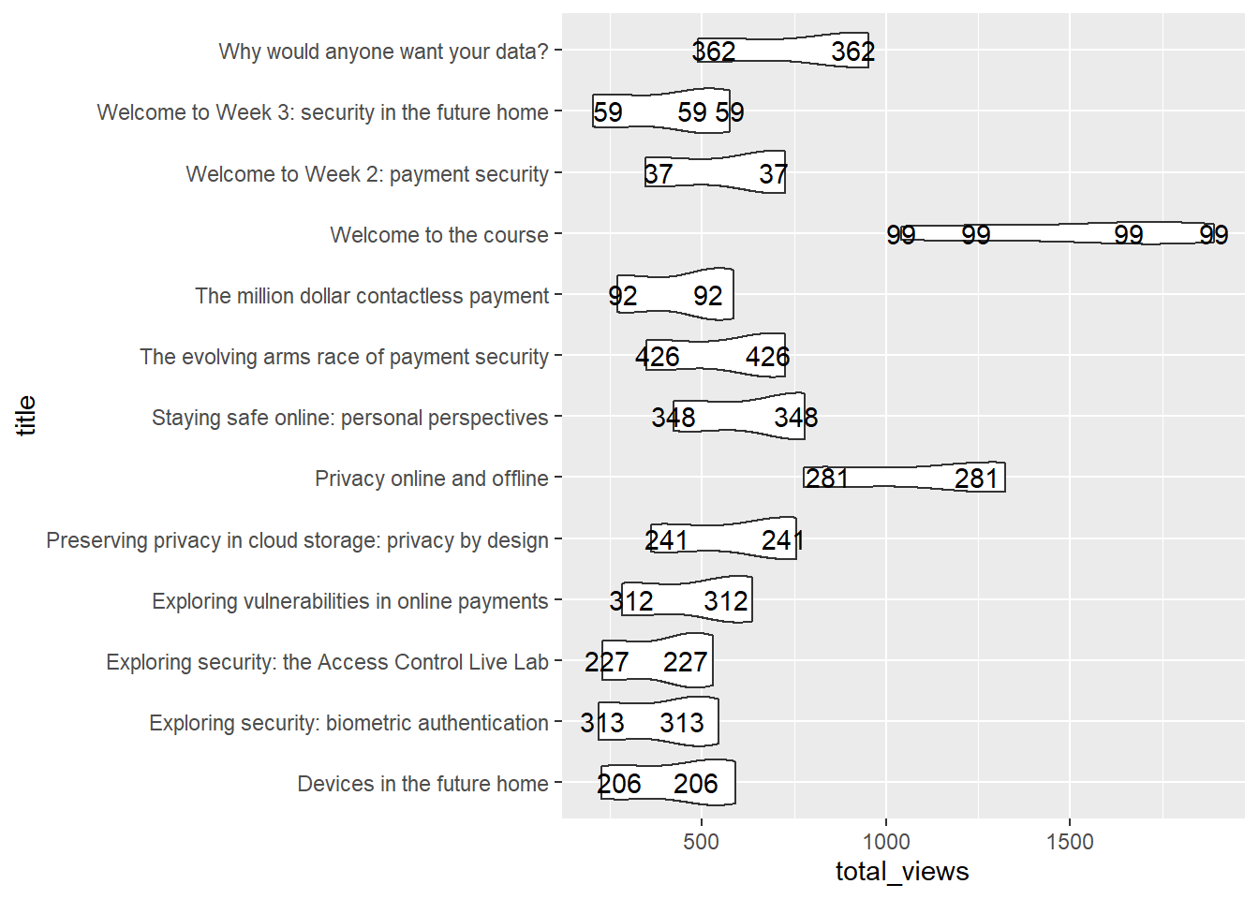
Total Views across all Videos
The Welcome to the course video is the most watched video followed by Privacy online and offline.
There is little variation across the other videos with a 2% watch rate.

Slide 20
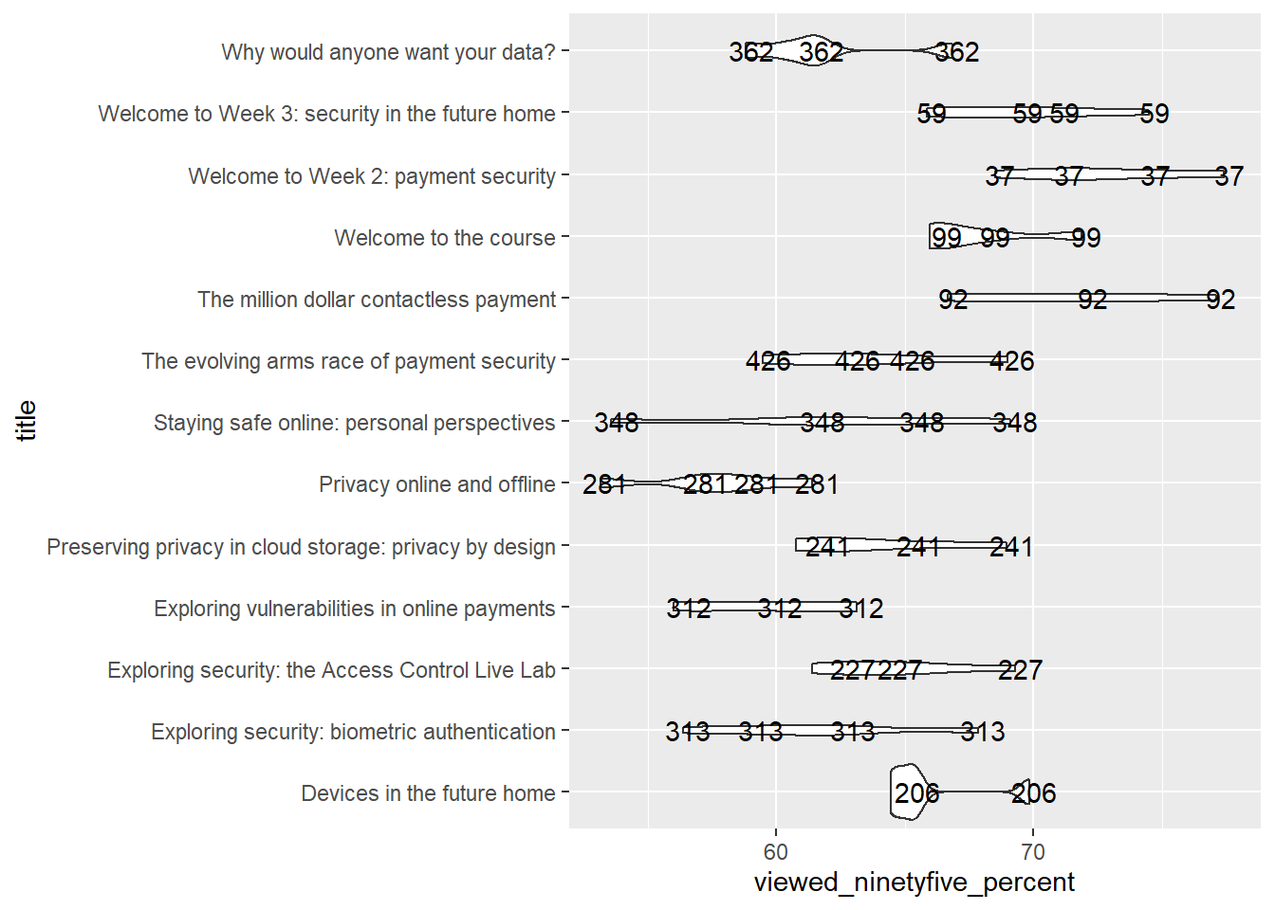
Total Views Across All Videos
The Welcome to the course video is the most watched video followed by Privacy online and offline.
There is little variation across the other videos with a 2% watch rate.

Slide 21
Future Work?
Predicting likelihood of learners quitting early
Suggesting activity types that learners engage with most

Slide 22

Lessons Learned

Slide 23

Thank ou
A complex idea can be conveyed with just a single still image, namely making it possible to absorb large amounts of data quickly.

Slide 24
And tables to compare data
 | A | B | C
Yellow | 10 | 20 | 7
Blue | 30 | 15 | 10
Orange | 5 | 24 | 16

Slide 25
Thanks!
Any questions?
You can find me at:
@github.com/simontirvine

